Slide 1


SQL Saturday in Smithfield, RI December 9th Pre Con: R from A to Z
http://www.sqlsaturday.com/694/EventHome.aspx
Use Discount Code Microsoft
For 20% Off
https://r_programming.eventbrite.com

Slide 2

The Story of the Five Iron

Slide 3

Power BI with R

Slide 4
R is to Power BI as…

Slide 5

Underdog’s Ring is to Underdog

Slide 6

Spinach is to Popeye

Slide 7

The Utility Belt is to Batman

Slide 8
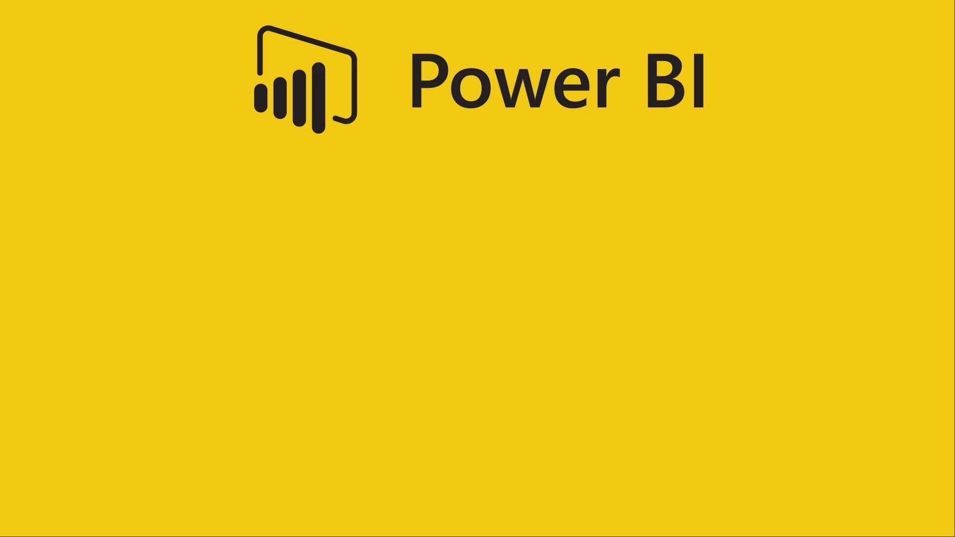
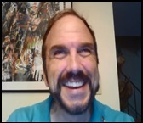
Giving SupeR Powers to Power BI
by Bryan Cafferky

Slide 9

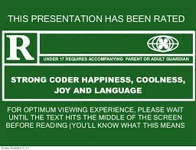
For Language and graphics

Slide 10
Presentation Goals
Why Do We Need R?
R Primer
R as a Data Source
R Transformations
R Visuals
Slides Available at:
https://github.com/bcafferky/shared/tree/master/PowerBIwithR

Slide 11
What is R?
R is an open source language for Data Science.

Slide 12
Why Use R?
Can do things in Power BI that cannot be done without it.
Tell stories involving machine learning.
Show the research, i.e. how did we get here.
Extend your skillset.
Data Exploration.

Slide 13
R Features
Scripting language like Python, BASH, Perl, or PowerShell.
Vast library of statistical functions.
Support to create impressive visualizations.
Extensive free open source libraries by the user community.

Slide 14

Getting Things Set Up

Slide 15


Get and Install R and R Studio
R CLI – Command Line interface.
https://cran.r-project.org/bin/windows/base/
Designed for interactive single command at a time. Must install this.
R Studio – An Integrated Development Environment.
https://www.rstudio.com/products/rstudio/download/
A complete script development environment.

Slide 16
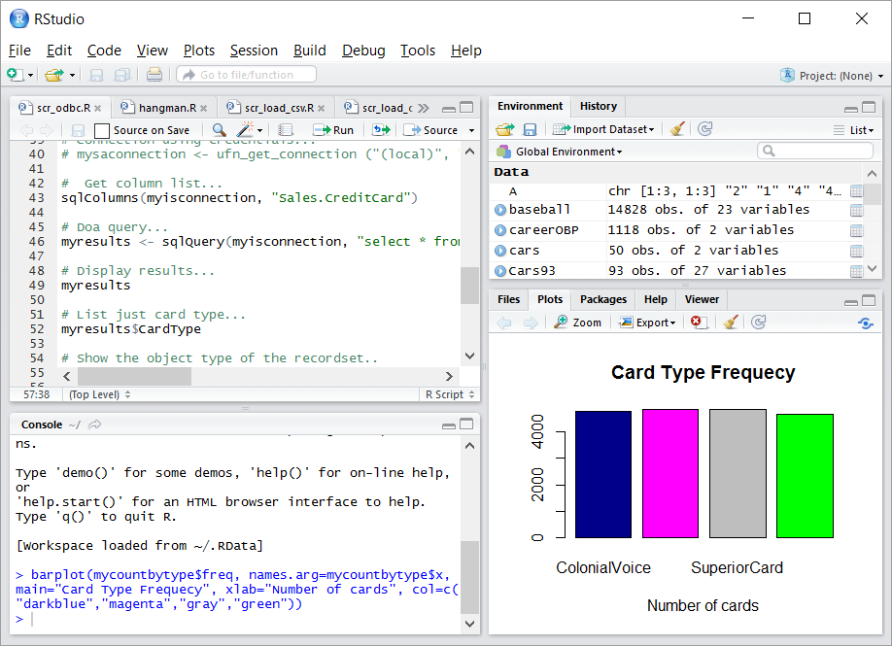
RStudio
Environment Memory
Script Editor
Tabbed Views
R Console

Slide 17
R Primer
R Studio
Vectors
Data Frames
Visualizations

Slide 18

It was rumored that the Apple logo was in honor of this pioneer of Computer Science.

Slide 19
It was rumored that the Apple logo was in honor of this pioneer of Computer Science.
Alan Turing – an apple with a bite out of it was found next to him.

Slide 20
Using R with Power BI

Slide 21
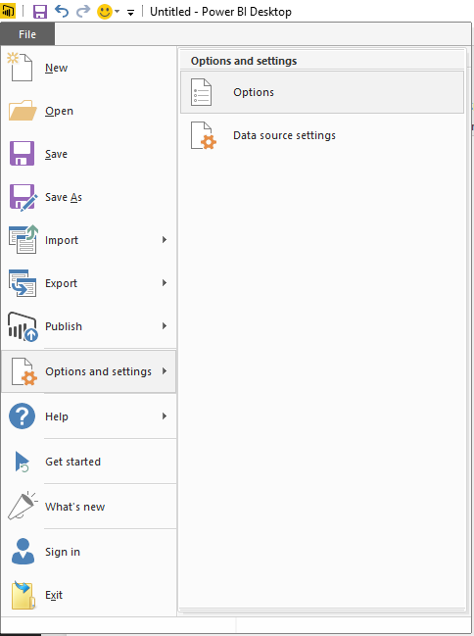
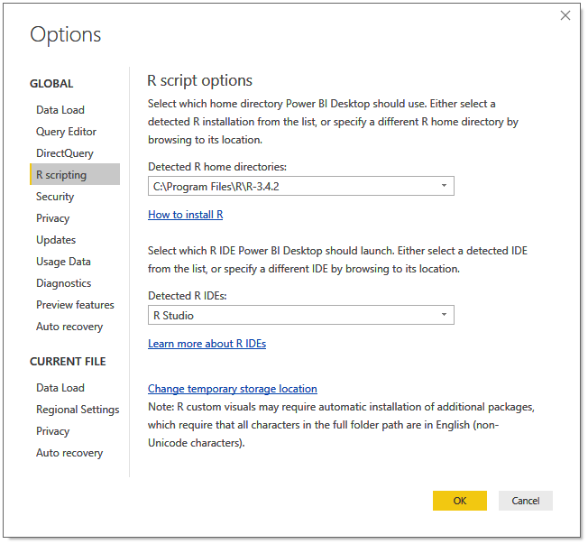
Enabling R Scripts
Select Options

Slide 22
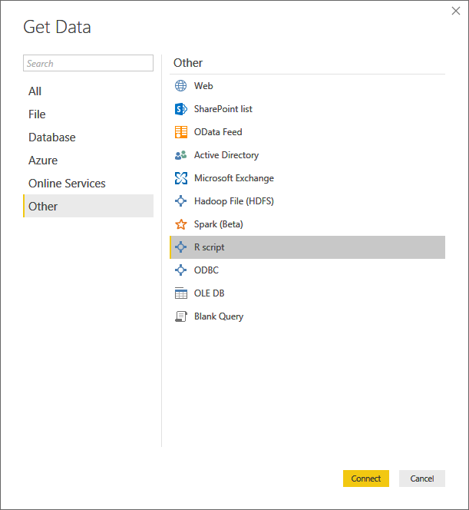
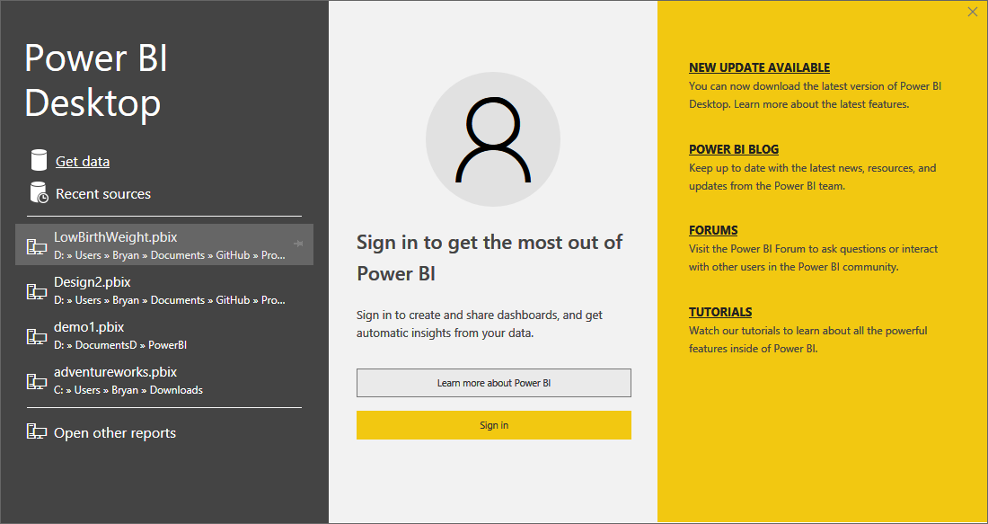
Power BI R Script as a Data Source

Slide 23
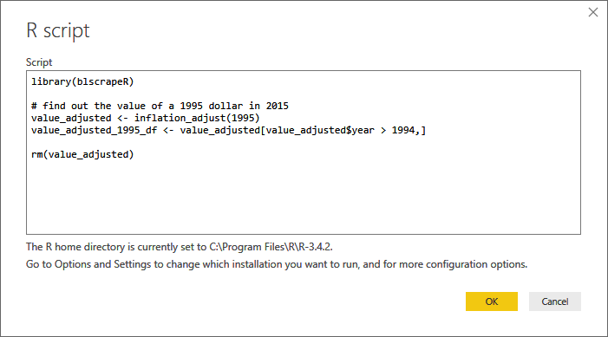
Power BI R Script as a Data Source
Load an installed package.
Function returns a data frame.
New data frame based on value_adjusted
Remove unneeded data frame.

Slide 24
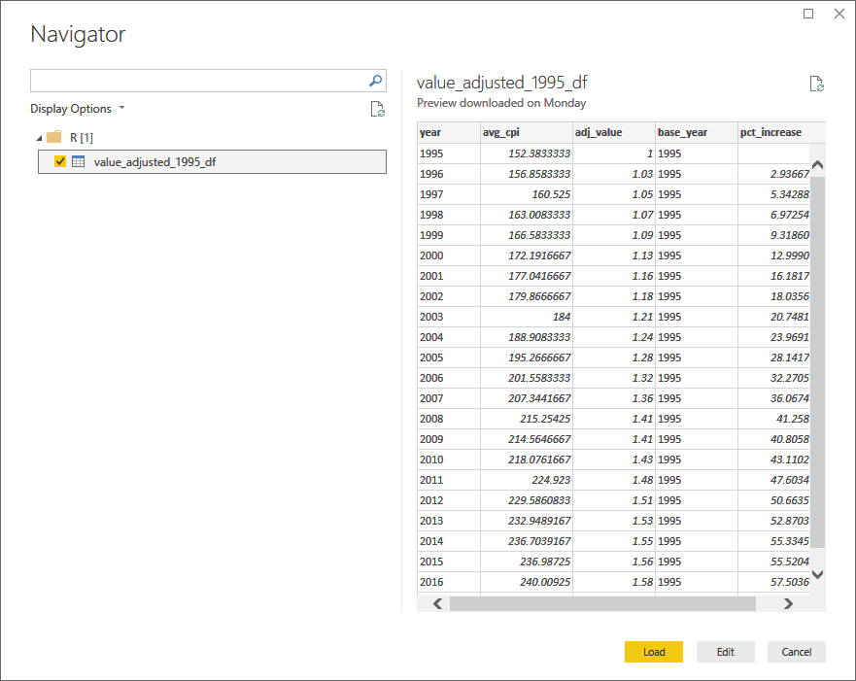
Power BI R Script as a Data Source

Slide 25
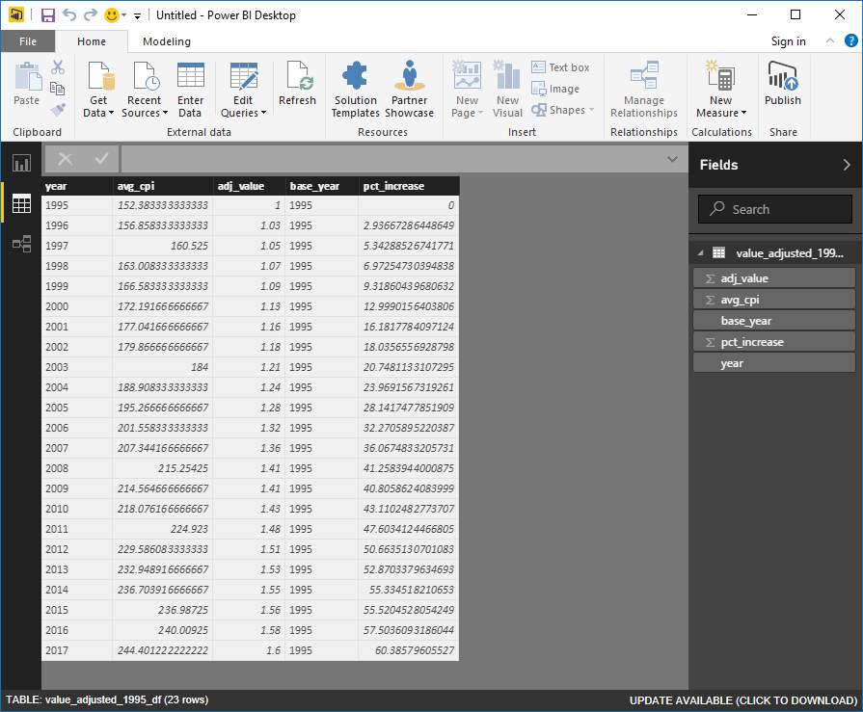
Power BI R Script as a Data Source

Slide 26
Demo
Loading Data from an R Script
r_adjusted_values_load.r

Slide 27
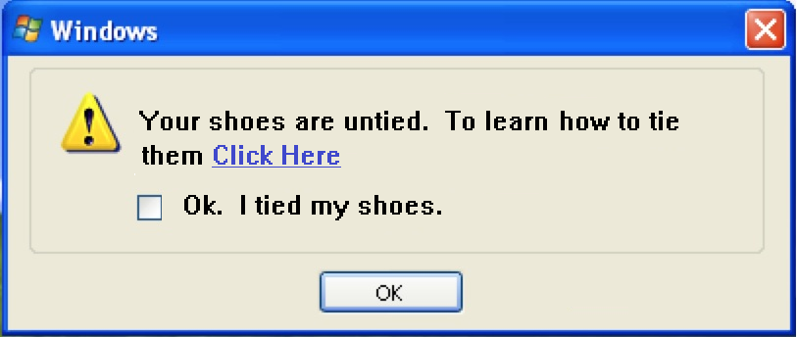
Windows with AI Enabled

Slide 28
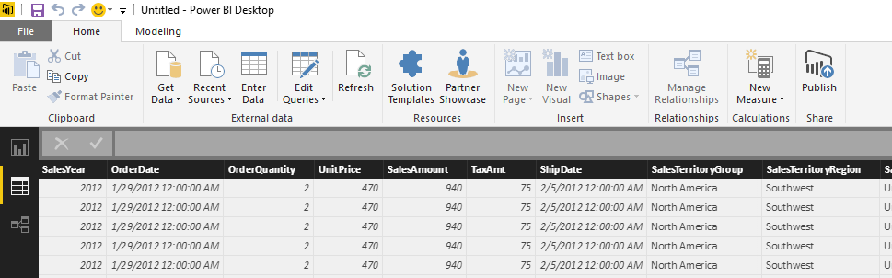
Transformation Script
Click on Edit Queries

Slide 29
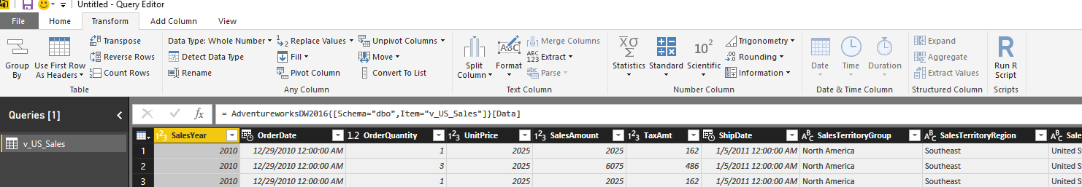
Transformation Script
Click on Transform
Click on Run R Script

Slide 30
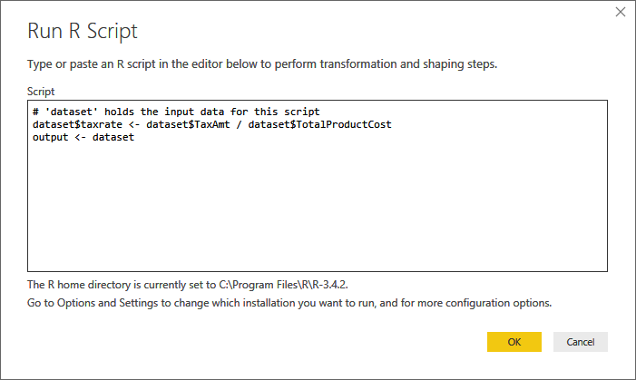
Transformation Script
Power BI Passed Data In as the dataset data frame.
Data is returned via the output data frame.

Slide 31


Slide 32
Demo
Transforming Data from an R Script
scr_transformation.r
Scr_power_bi_sales_adjusted_measure

Slide 33
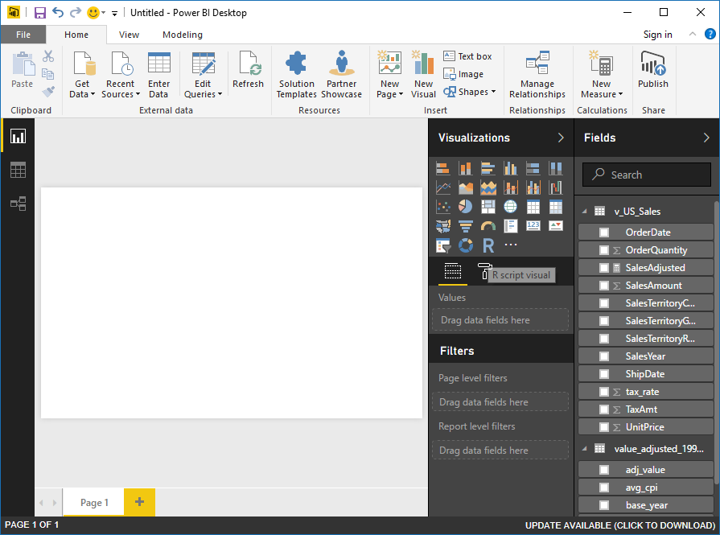
Visualizations with R
Click on R

Slide 34
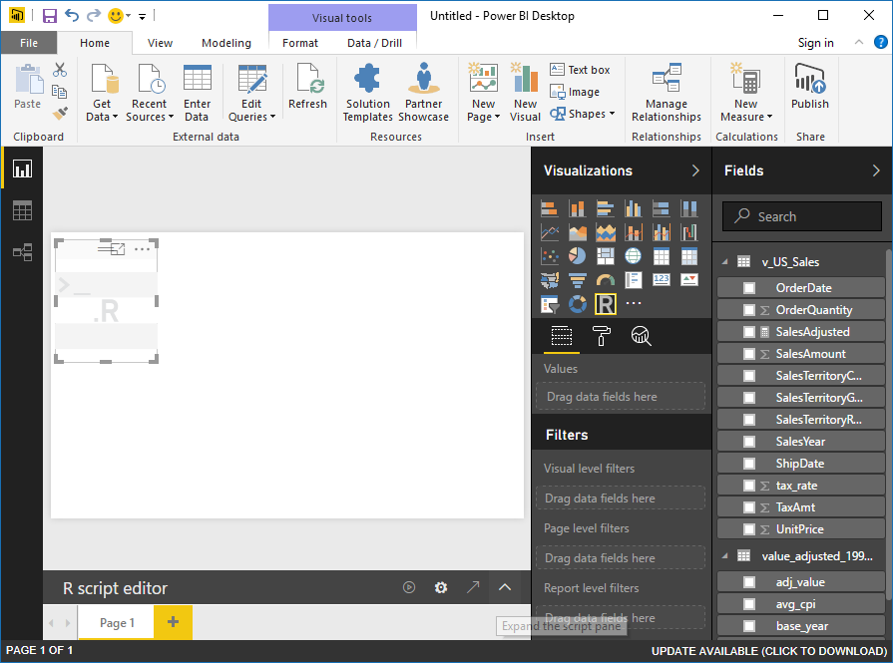
Visualizations with R
Expand Code Window

Slide 35
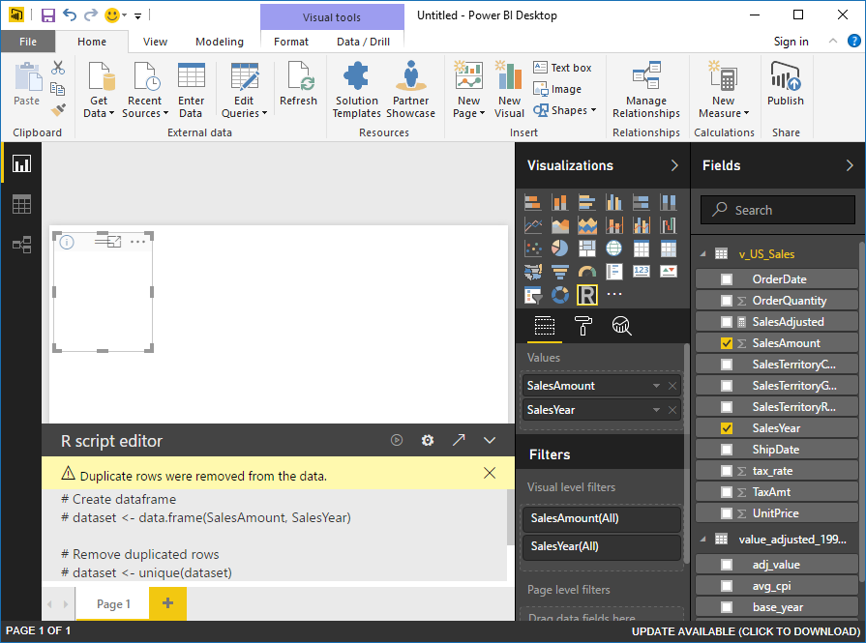
Visualizations with R
Data passed to Script as dataset data frame.

Slide 36
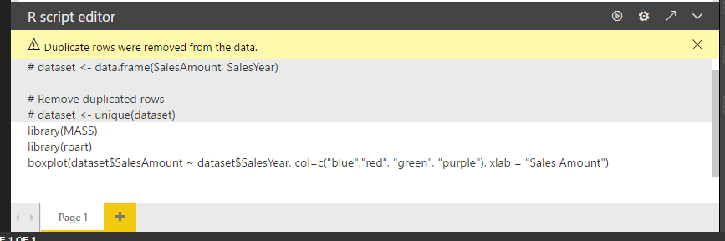
Visualizations with R
Packages must be installed.
Code renders visualization.

Slide 37

Visualizations with R
Run Script
Script Options
Go To R IDE
Expand/Contract Script Pane

Slide 38

Why is Spock’s shirt blue in Star Trek The Original Series?

Slide 39
Why is Spock’s shirt blue in Star Trek The Original Series?
Blue stands for Science and Medical Service.

Slide 40
Demo
Loading Data from an R Script
r_visualization.r

Slide 41
Visualizations with R

Slide 42
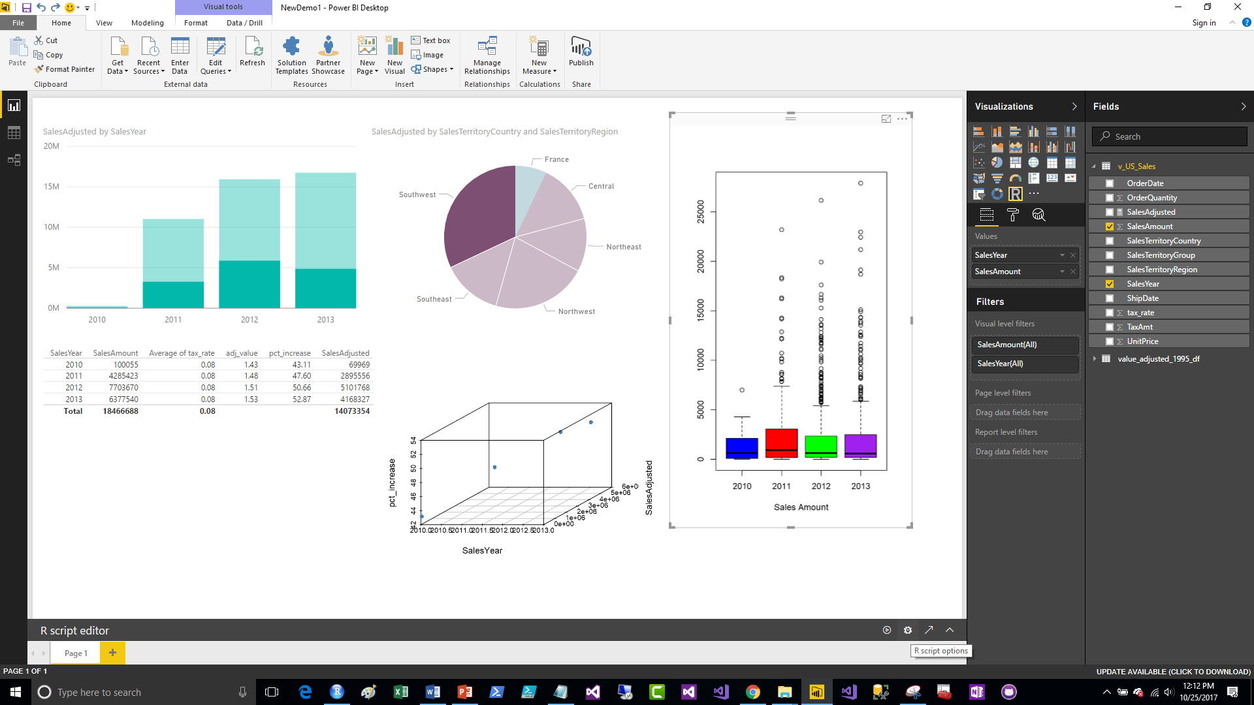
Visualizations with R
Click to Edit R Script

Slide 43
Demo with Predictive Model

Slide 44
Data Sources
Built In R Data
data()
MRAN
R Packages that Get Data
https://mran.microsoft.com/documents/data/
http://blog.revolutionanalytics.com/2016/01/new-data-sources-for-r.html

Slide 45
Review
R is a popular open source data science language.
The Comprehensive R Archive Network (CRAN) maintains R.
R has rich support for statistics and visualizations.
R is a vectorized language.
R is Extended with new Functionality via Packages.

Slide 46

Q & A
Data Solutions Consultant and Trainer.
Decades of IT Experience in health care, insurance, banking, and ecommerce.
Microsoft MVP.
Author of Pro PowerShell for Database Developers.
Founded and lead PASS Chapter The RI Microsoft BI User Group and The SNE R User Group.
Frequent presenter at technical conferences and user groups.
bryan256@msn.com
www.sql-fy.com
https://www.linkedin.com/in/bryancafferky
@BryanCafferky – follow me!
Subscribe to me on YouTube!

